Slide 1

Lorentzian Anomaly Attention (LAA):
A Self-Attentive Approach to Citation Networks
Adar Budomski 206539363
Shoval Ben Shushan 207502428
Supervisor: Dr.Dvora Toledano-Kitai
Project number: 25-2-R-1
Notes:
שובל

Slide 2
Motivation
Citation networks are complex and evolve rapidly due to the surge in scientific publications.
Citations may show atypical trends: early peaks, delayed impact, or sudden drops.
Identify such anomalies reveals unusual scientific influence
Static graph analysis approaches struggle to capture dynamic and hierarchical patterns.
Notes:
שובל
The structure of citation networks is increasingly dynamic, driven by the rapid and continuous growth in scientific publications.
Static graph analysis methods fall short in capturing evolving behaviors and hierarchical patterns in time-varying networks.
Citation patterns often deviate from expected norms, exhibiting early peaks, delayed recognition, or abrupt declines.
Detecting such anomalous patterns is crucial for identifying papers with unexpected impact trajectories and understanding emerging trends in science.

Slide 3
Current State and Project Need
Limitations of Existing Tools
Challenges in Manual Detection
Need for an Appropriate Approach
Existing Euclidean-based embeddings methods fail to capture complex citation dynamics.
Manual analysis is impractical given the pace and volume of publications.
A new model is needed that combines geometric structure with temporal information for better anomaly detection.
Notes:
שובל
Many existing models embed nodes in Euclidean space, which assumes polynomial growth and fails to reflect the hierarchical and rapidly evolving structure of citation networks
Citation dynamics often follow exponential trends—requiring hyperbolic geometry to capture them effectively
Manual Detection Doesn’t Scale
Analyzing citation trends manually is time-consuming and impractical, especially with the rapid growth of scientific publications.
Need for a Smarter Model We need a model that combines geometric structure—captured through hyperbolic embedding—with temporal dynamics, enabling better detection of unusual citation behavior over time.

Slide 4

Citation Networks
A citation network represents academic papers as nodes and citation links as edges.
As new papers and citations are added over time, the network evolves dynamically, in contrast to static networks that capture a fixed view.
Analyzing these evolving patterns helps reveal emerging research trends and unusual citation behaviors.
Notes:
שובל

Slide 5
Euclidean vs. Hyperbolic Embedding
Euclidean Embedding | Hyperbolic Embedding
Intuitive and simple geometry | Naturally captures hierarchical and scale-free structures
Efficient computation and well-established algorithms | Compact and expressive in low dimensions
Limited expressiveness for hierarchical or complex networks | Models structural and temporal dynamics effectively
Poor fit for power-law structures and dynamic evolution | Lower distortion and better suited for large-scale dynamic networks
Notes:
אדר

Slide 6
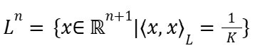
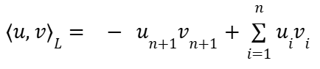
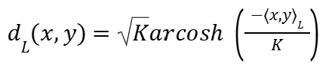
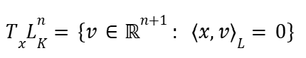
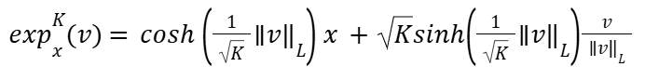
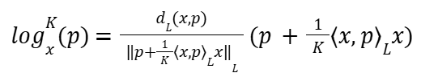
The Lorentz Model of Hyperbolic Space
Space Definition
Lorentzian Inner Product
Distance
Tangent Space
Exponential Map
Logarithmic Map
Notes:
אדר

Slide 7
The DynHAT Model in Lorentz Space
Preprocessing
Prepare a dynamic representation of the network over time
Structural Representation Layer
Capture the hierarchical structure of the network at each time step
Temporal Representation Layer
Model the temporal evolution of node representations across time
Link Prediction
Predict future or missing links between nodes based on their dynamic evolution
Anomaly Detection
Detect unusual citation patterns or behaviors based on the temporal dynamics of node representations
Notes:
אדר

Slide 8
Anomaly Detection
Detecting Deviations
Evolving Citation Networks
Identifies patterns or behaviors that deviate from the norm.
Tracks how citation patterns change over time in dynamic networks.
Citation Anomalies
Scientific Impact
Detects sudden citation spikes, delayed growth, or unusual connections.
Reveals citation manipulation, breakthrough research, and emerging trends.
Notes:
שובל

Slide 9
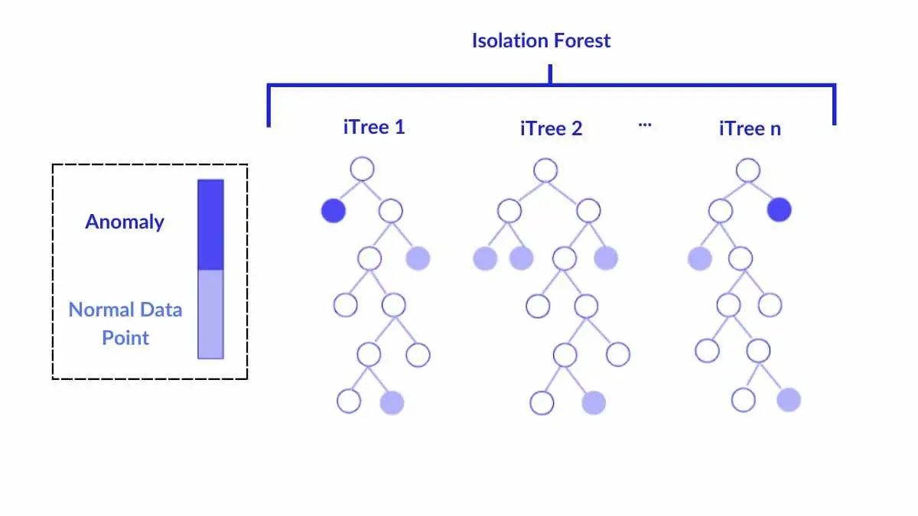
Isolation Forest (IF)
No Distribution Assumptions
Tree-Based Method
Reachability Distance
Efficient & Scalable
Notes:
שובל

Slide 10
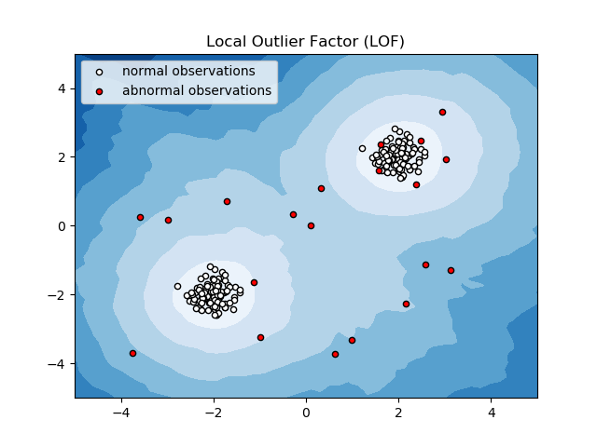
Local Outlier Factor (LOF)
Local Perspective
Density-Based Detection
Isolation Depth
Effective in Complex Data
Notes:
שובל

Slide 11
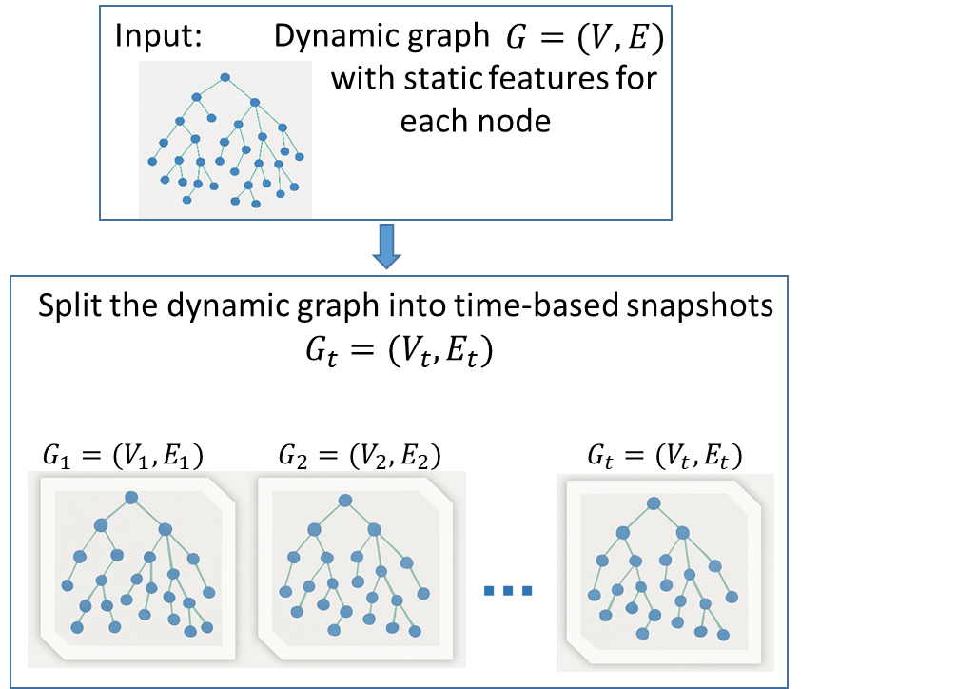

Proposed Model

Slide 12
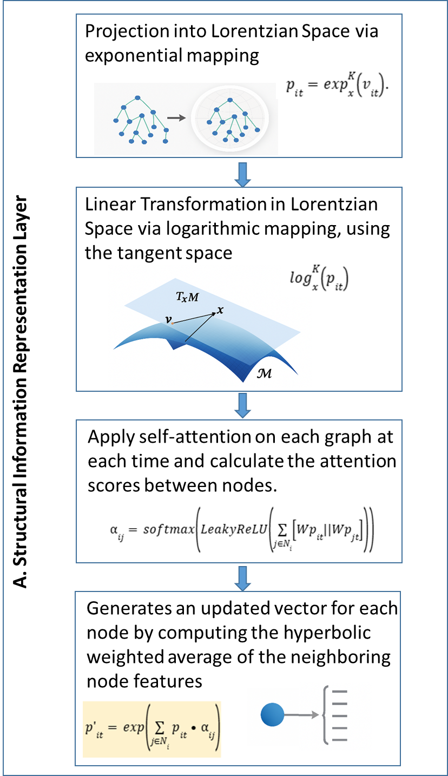
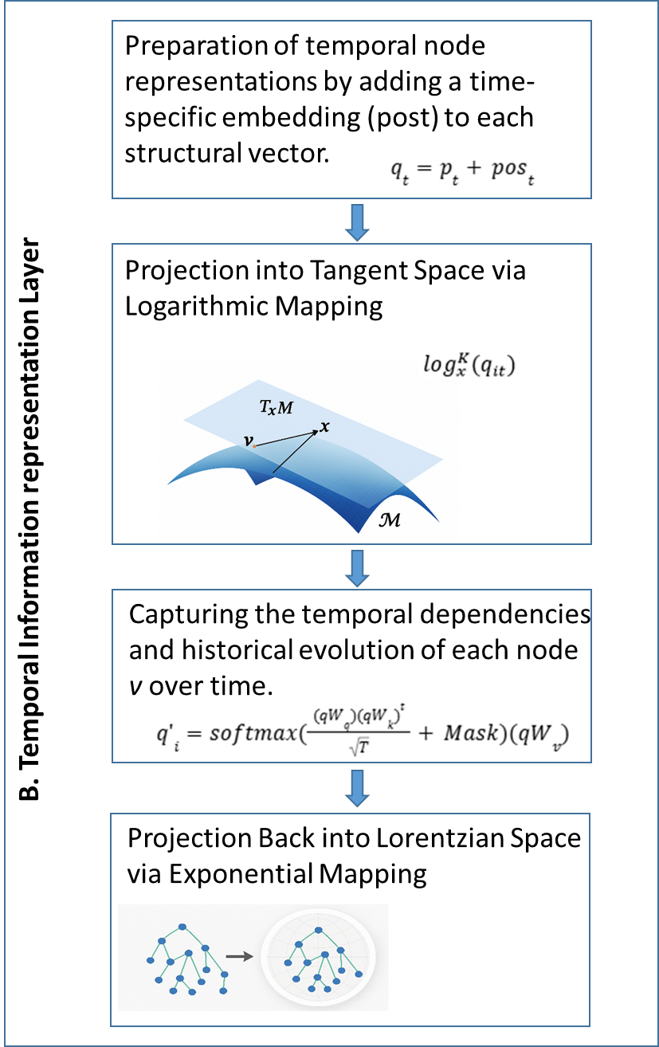
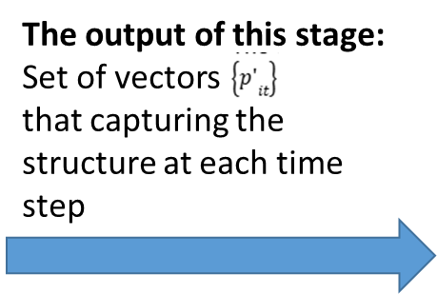
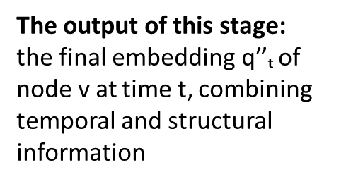
Proposed Model

Slide 13

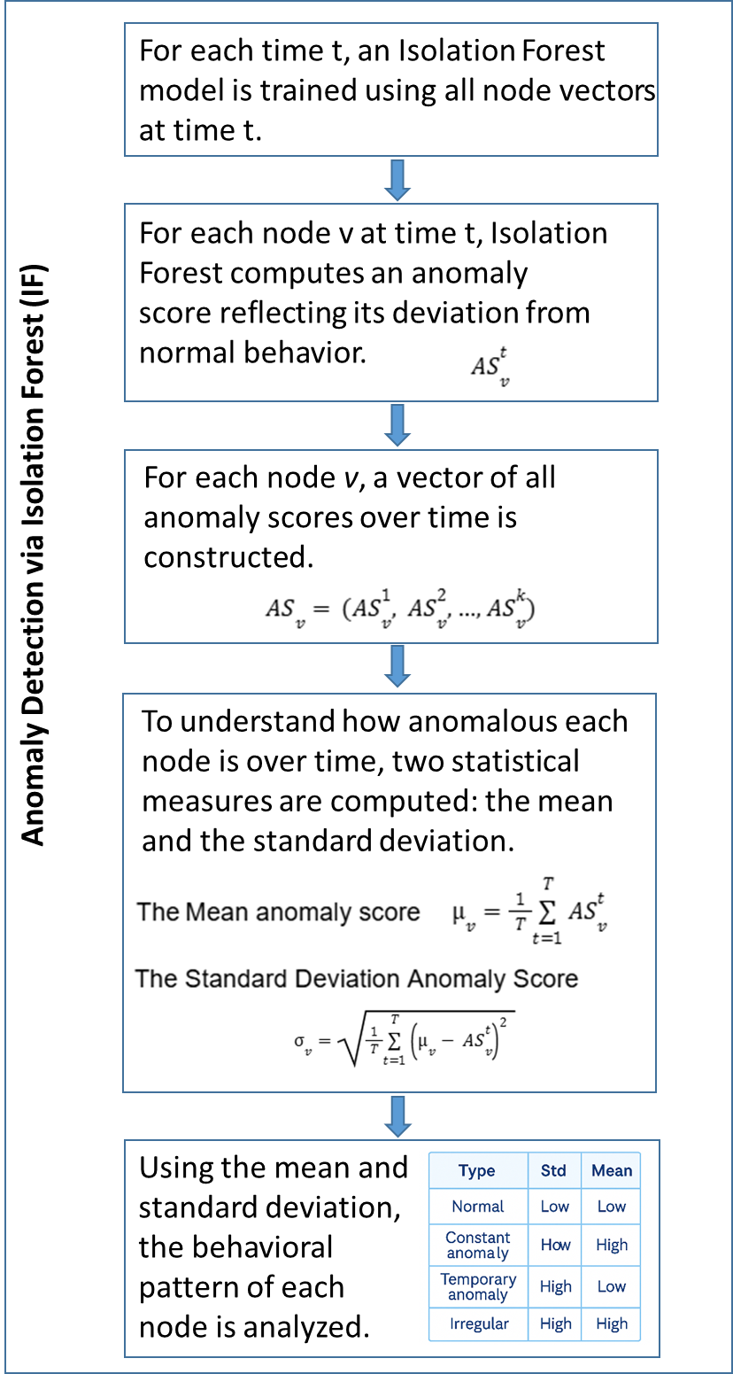
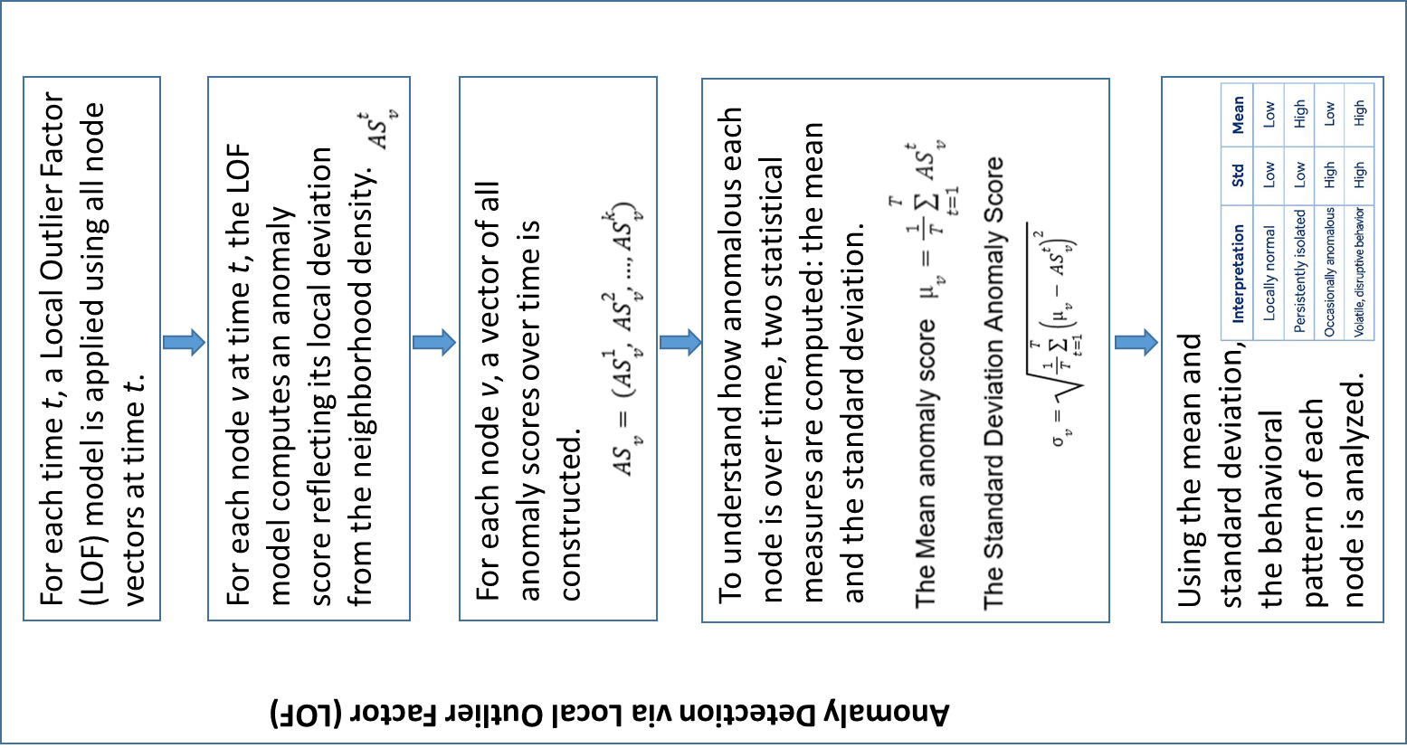
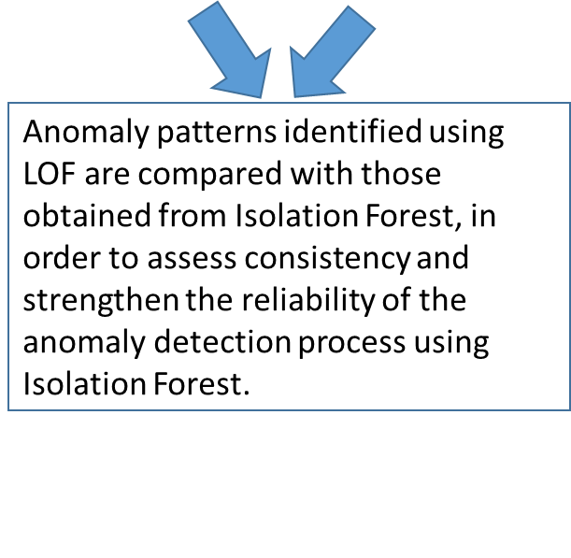
Proposed Model

Slide 14
Validation Phase
Collect anomaly scores for real and fake nodes
Iterative Noise Injection:
Analyze Stability of Anomaly Scores Across Iterations
Compute validation metrics (TPR, FPR)
Structural noise injection using fake nodes
Execute full pipeline with detection evaluation
Repeat for N iterations

Slide 15
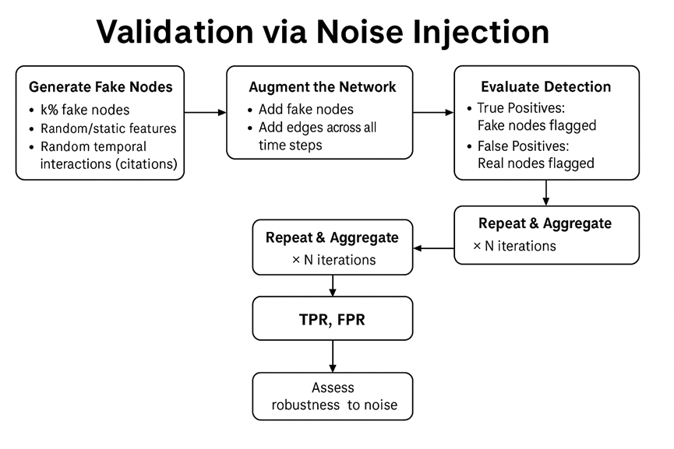
אם רוצים גרסה יותר מורחבת ( לדעתי אין צורך- יותר מתאים לשלב ב כי בשלב א יש תכן ראשוני)

Slide 16





Tools & Technological Framework
Notes:
אדר

Slide 17

Expected Results
Expected results include high-accuracy detection of temporal citation anomalies, generating anomaly profiles per paper, and identifying irregular patterns such as early spikes or delayed recognition.
The model is expected to achieve ≥85% true positive rate with low false positives, validated through synthetic anomaly injection.
Notes:
אדר

Slide 18
Challenges
Identifying a Suitable Dataset
Developing Academic Writing Skills in English
Selecting an Appropriate Development and Execution Environment
Familiarization with Hyperbolic Geometry
Integration of Model Components
Deepening Understanding of Advanced Deep Learning Models
Phase A
Phase B
Notes:
אדר

Slide 19
Thanks!
Do you have any questions?

